Slide 1
Objective 12:
50% of public non-charter schools participating in the wellness survey must meet at least 90% of the Wellness Guidelines
This institution is an equal opportunity provider
School Food Services Branch

Slide 2
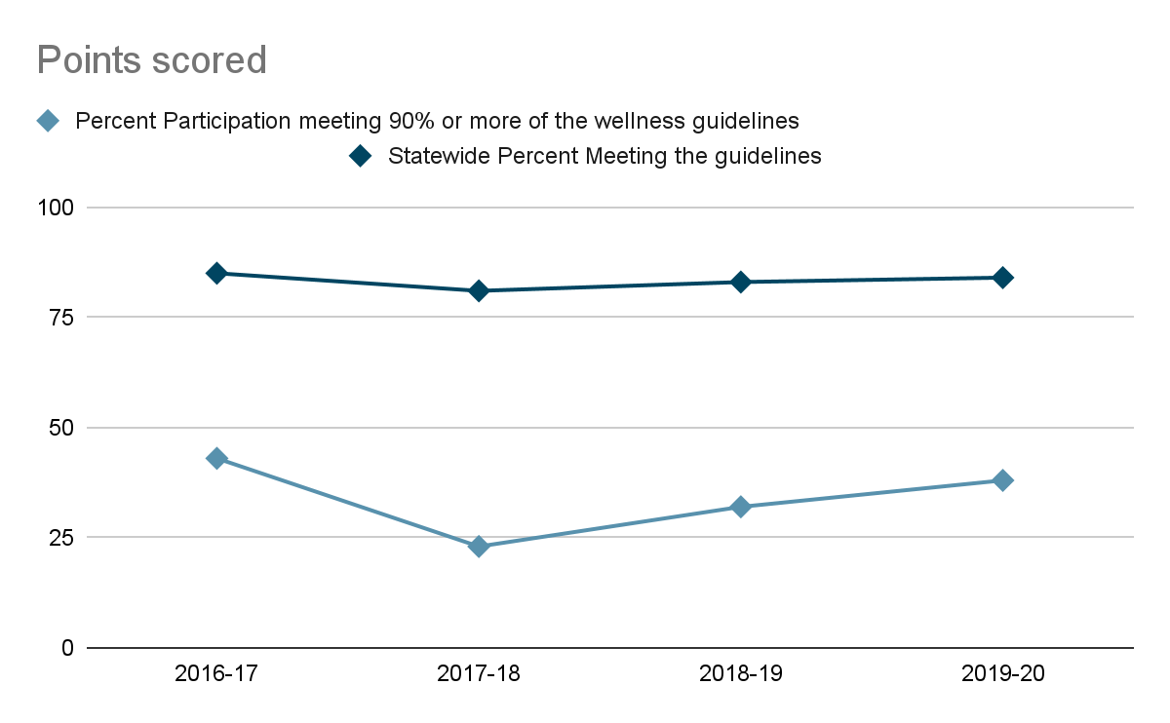
School Food Services Branch
SAWS completion rate in 2023
This institution is an equal opportunity provider
99%
Notes:
This past year 2022-2023 school year there were 255 out of 258 eligible schools that completed the 2023 Safety and Wellness Survey
82% completion rate in 2022 and now a 99% completion rate in 2023
20-21 SAWS data cannot be compared to previous says report data due to questions being dropped to accommodate school changes during the covid 19 pandemic.
DOE revised it’s policy in March of 2017

Slide 3
How can schools be better equipped or supported?
This institution is an equal opportunity provider
School Food Services Branch
Complete the Safety and Wellness Survey annually
Supporting Wellness Coordinators in implementation
Celebrating our strengths and achievements as a model for others.
Notes:
Based on the latest Triennial Assessment results schools can be better supported by completing the SAWS every year and identifying officials responsible for implementation of the wellness guidelines
Increasing awareness and school support in areas that fell short of full implementation of the wellness guidelines
Celebrating achievements in schools and recognizing schools for their strengths in Wellness as a model for others.
Other notes:
Majority of the guidelines besides the ones scoring below 60% were scoring consistently within +/- 5 percentage points from SY 2017-2018- SY2019-2020.
NG8 (Food is not used as a reward or punishment) saw an increase from 53% in the 2018-2019 SAWS report to 68% in the 2019-2020 SAWs.
NG4 ( Fundraising activities that promote physical activity, non-food items, or healthy foods based on Smart Snacks standards are encouraged.) saw a steady increase from 77% in 2017-18 to 92% from 2019-20.
HE2 ( Health education is provided to students in elementary grades at least 45 minutes per week and secondary grades at least 200 minutes per week as measured by time spent in a course, integrated into multiple content areas, or through interdisciplinary units.) saw an increase from 79% in 2017-2018 to 85% in 2019-20.
PE2 ( Physical education is provided to students in elementary grades at least 45 minutes per week and secondary grades at least 200 minutes per week.) saw an increase from 81% in 2017-2018 to 90% in 2019-20

